Slide 1
“The Demographics of Aging: When Statistics Don’t Lie”
Professor Lené Levy-Storms
Gerontology Interdisciplinary Minor (GIM)
&
The Gerontology & Geriatrics Interest Group (GIG) Team

Slide 2
ACKNOWLEDGEMENTS
Brittany Barba & Lia Watai Marshall
The Office of Instructional Development
The Luskin School of Public Affairs
Special thanks to Dr. Todd Franke &
The Social Welfare Department

Slide 3
My Generation
http://www.youtube.com/watch?v=zqfFrCUrEbY

Slide 4
Age, like death (& taxes), is in our guts. It is one thing we can be 100% sure of.
“Old age is still new.”
– Naomi Feil
Youth is a Gift of Nature Age is a Work of Art
Chinese Proverb

Slide 5
Longevity Revolution Video
http://www.youtube.com/watch?v=dWUw3ZLrJ08

Slide 6
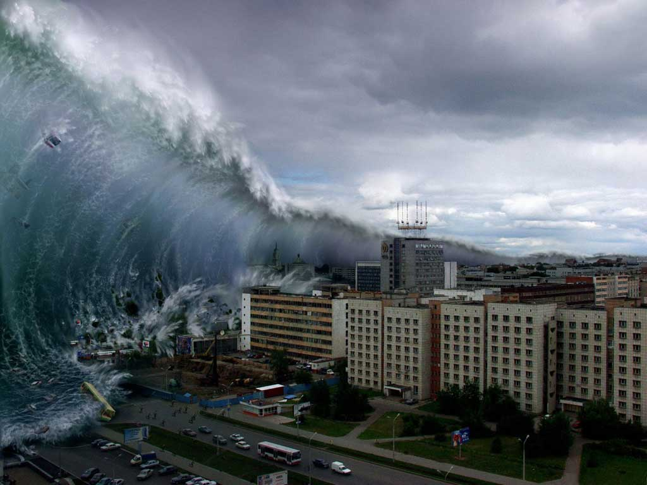
The Age Wave

Slide 7
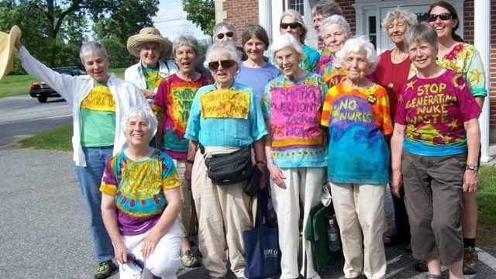
The Longevity Revolution

Slide 8
What have you heard?

Slide 9
Variations on Extending Life
Life Span: defined as the longest number of years any member of a species has been known to survive.
Life Expectancy: the average number of years people in a given population can expect to live, or more precisely, the mean age at death.

Slide 10
Madame Jeanne Calmont

Slide 11
“Elevator” Facts
NOW: Over one in every eight, or 13.3%, of the population is an older American.
PROJECTED: By 2030: Almost 1/5 (19%) of Americans will be over 65 – look like Florida
NOW: Persons reaching age 65 have an average life expectancy of an additional 19.2 years (20.4 years for females and 17.8 years for males).
Baby Boomers: 1945-1964-- Every eight seconds a baby boomer turns 50 (U.S. Census Bureau, 1996)
NOW: The number of people today aged 60 and over has doubled since 1980.
PROJECTED: The number of people aged 80 years will almost quadruple to 395 million between now and 2050.

Slide 12
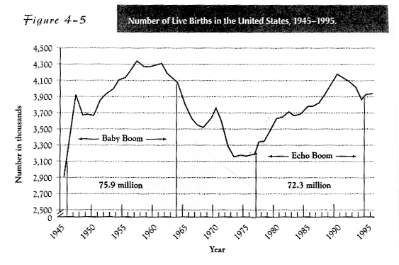
BOOM!!!……..Boom!!!
Source: Jil Quadagno, 3rd ed., 2004, p.82

Slide 13
AGING 101
Age is only a number
Functional, psychological, social
65 and older is arbitrary
Policy
Growth of 65+ population
Projections of 65+ populations

Slide 14
Definitions of Age
Chronological Age
Social Age
Functional Age
Subjective Age
Notes:
Chronological Age – age in years
Determining adulthood by age (18/21)
Determining old age by years (65)
Social Age- age by roles
Functional Age – age by physical abilities
Measuring ability/disability
Subjective Age – “you’re as young as you feel”

Slide 15
“Statistics Don’t Lie”
Number “soup”
Number
Proportion
Rate
Incomplete picture of aging population from numbers alone

Slide 16
Total Population Growth in Numbers
Source: http://en.wikipedia.org/wiki/File:World-Population-1800-2100.svg

Slide 17
“Statistics Don’t Lie”
Brainstorm
Number “soup”
Number
Proportion
Rate
Incomplete picture of aging population from numbers alone

Slide 18
The USA: Two Population Pyramids

Slide 19
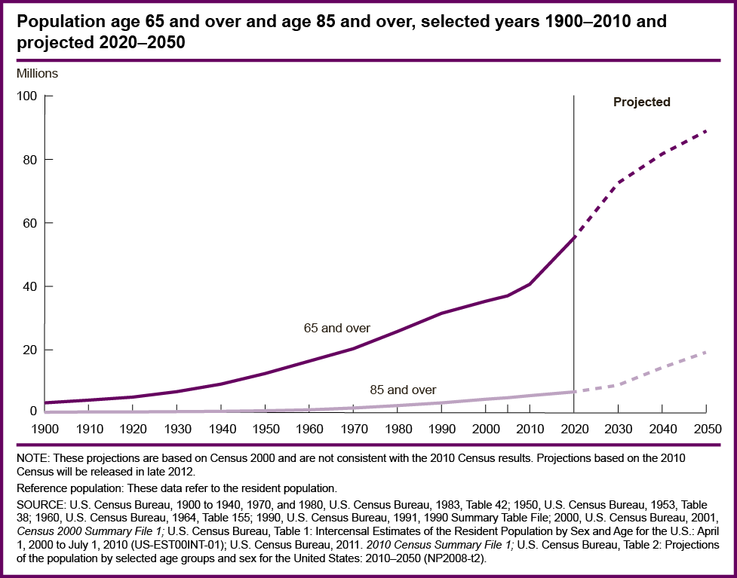
Number of Older Americans

Slide 21
Aging Population Growth in Percent
Source: http://www.nia.nih.gov/about/living-long-well-21st-century-strategic-directions-research-aging/research-goal-d-improve-our

Slide 22
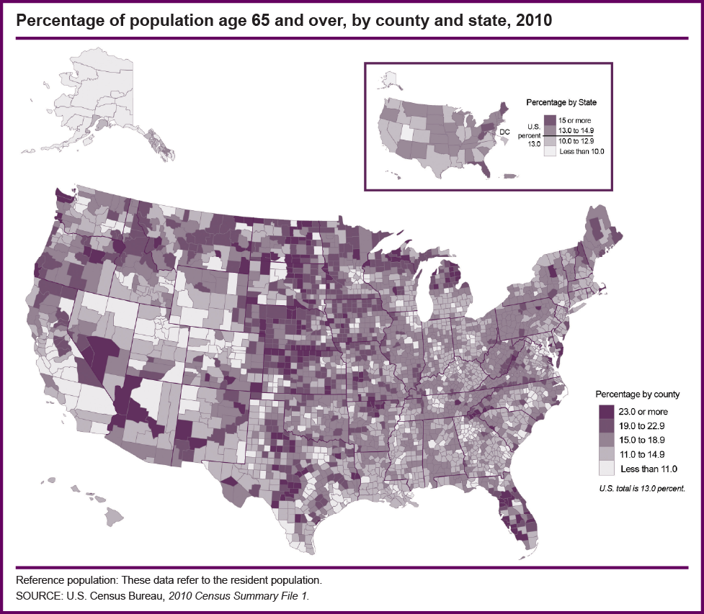
Number of Older Americans

Slide 23
Percentage of Population Age 65+ by State
Notes:
Slide 5 Percentage of Population Age 65+ by State
Here is the breakdown of the 65+ population by State…. (Older Americans 2000: Key Indicators of Well-Being, page 3)
Proportion is not the Ns
NE oldest then midwest and south. Young migrate out.
CA=4m
FL=3m
NY=2.5m
PN=2m

Slide 24
Rate of Growth in Aging Populations

Slide 25
Rate of Growth in Aging Populations
THE SPEED OF POPULATION AGING Number of years for population age 65+ to increase from 7% to 14%
Source: http://www.nia.nih.gov/about/living-long-well-21st-century-strategic-directions-research-aging/research-goal-d-improve-our

Slide 26
Table 5: Average Annual Rate of Population Growth, 1996-2020(%)
 | Total | School Age (5-14) | Working Age (15-64) | Elderly (65+)
World | 1.1 | 0.3 | 1.4 | 2.6
Sub-Saharan Africa | 2.3 | 1.9 | 2.6 | 2.8
Near East & North Africa | 2.1 | 1.2 | 2.5 | 3.7
China | 0.6 | -0.9 | 0.8 | 3.4
Other Asia | 1.4 | 0.2 | 1.8 | 3.4
Latin America & the Caribbean | 1.1 | -0.1 | 1.5 | 3.3
East & Central European States | 0.3 | -0.5 | 0.3 | 1.0
Rest of the World | 0.4 | -0.2 | 0.2 | 1.7
Source: International database, US Bureau of Census; WHO Kobe Centre, Ageing and Health

Slide 27
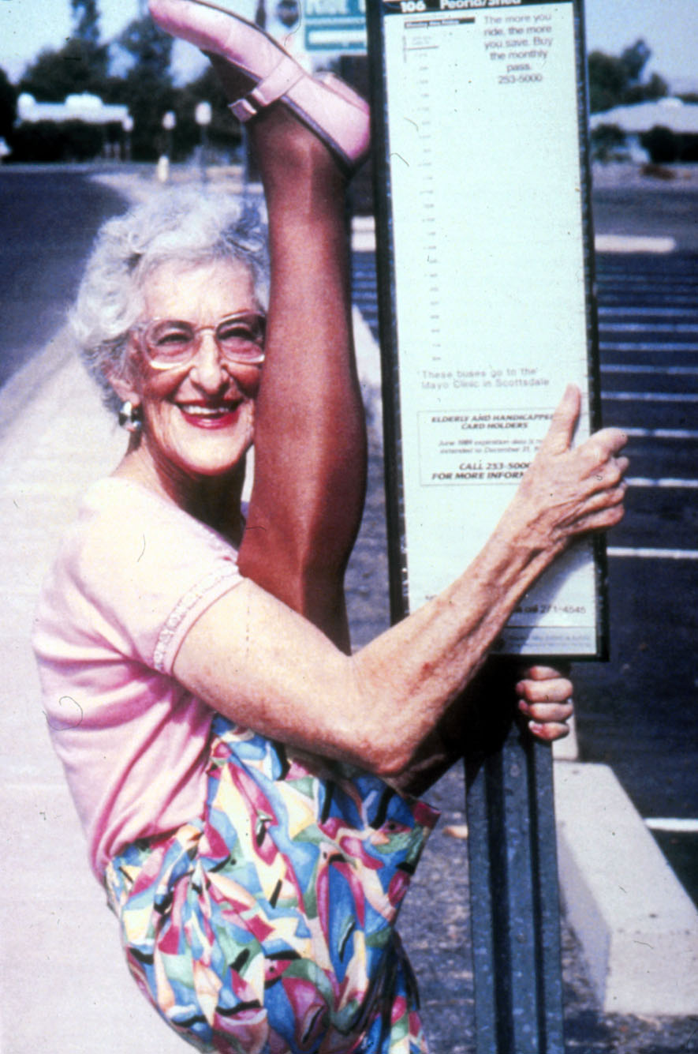
Foofie Harlan
Age 75
Cheerleaders’ Club

Slide 28
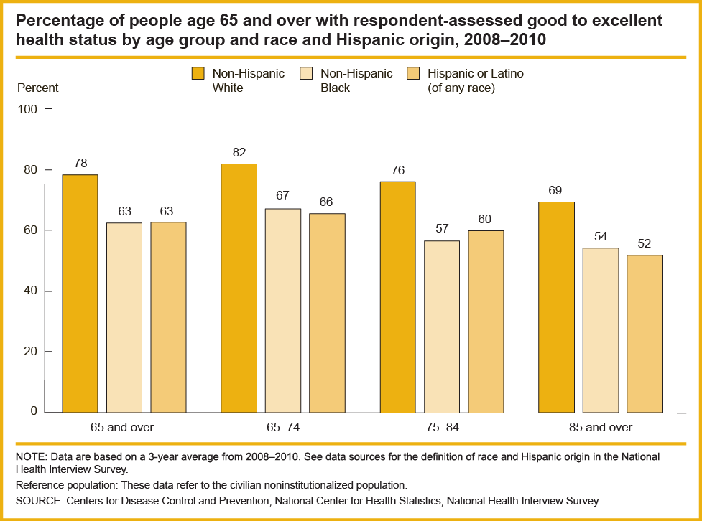
Respondent-Assessed Health Status

Slide 29
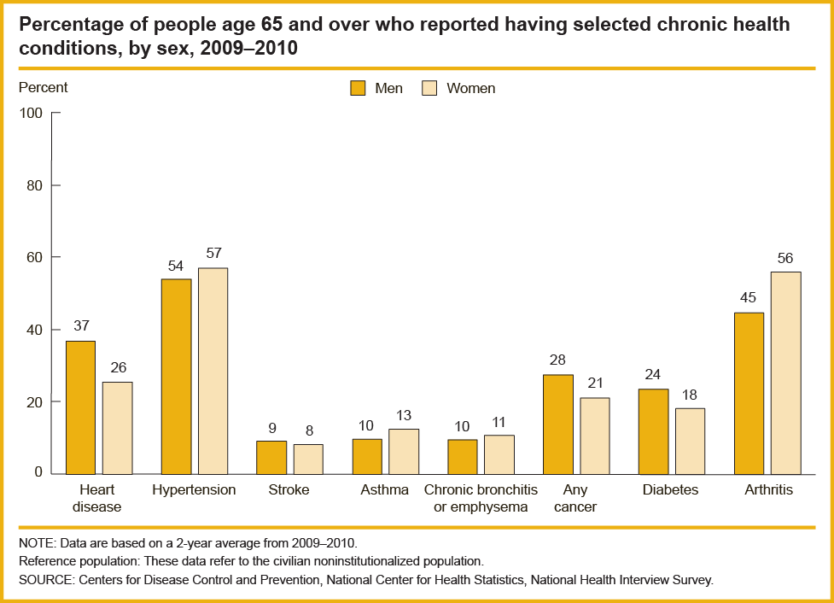
Chronic Health Conditions

Slide 30
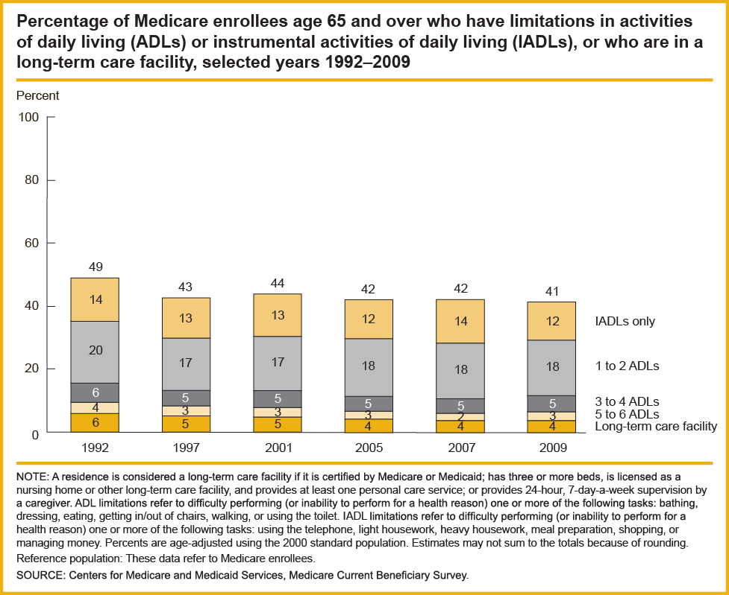
Functional Limitations

Slide 31
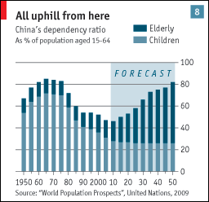
Dependency Ratios

Slide 32
Inter-Generation
Notes:
Similarity of experience within age groups“ . . . those born at the same time, may share similar formative experiences that coalesce into a ‘natural’ view of the world. This natural view stays with the individual throughout their lives and is the anchor against which later experiences are interpreted.”
Scott (2000, p. 356); Mannheim (1952 [1928])

Slide 33
In Conclusion
History is now
Explore the frontiers
Know the statistics for fun
Experience intergenerational interaction for the betterment of society

